Slide 1
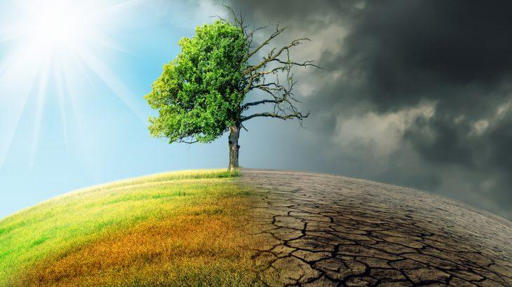
CLIMATE CHANGE
GROUP E

Slide 2
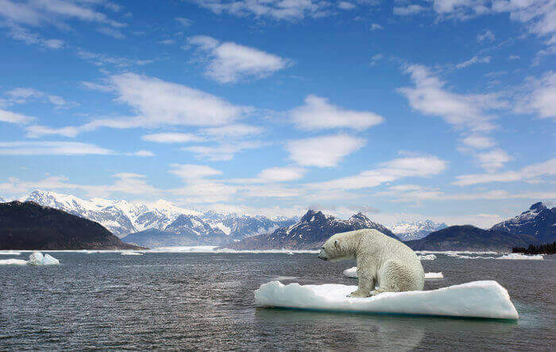
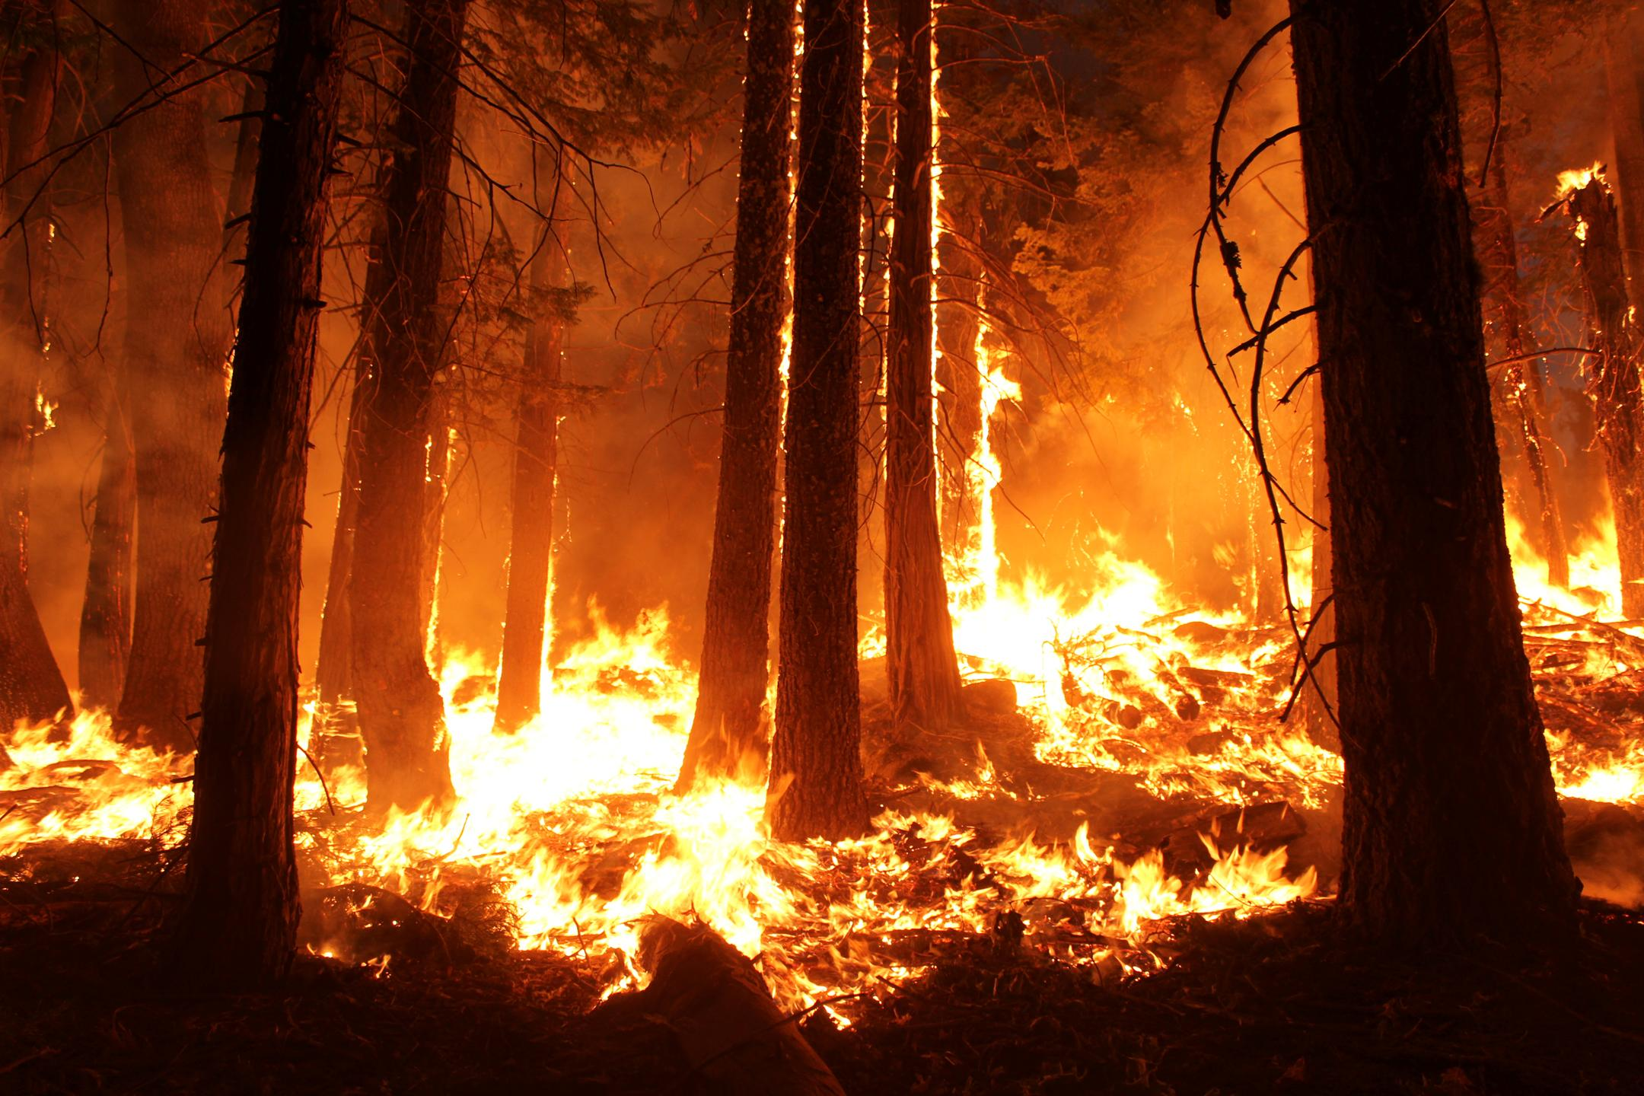
Effects the climate changes have on our planet
The global warming that’s changing our climate is already having serious consequences. In just the past few decades:
Rising temperatures have worsened extreme weather events.
Chunks of ice in the Antarctic have broken apart.
Wildfire seasons are months longer.
Coral reefs have been bleached of their colors.
Mosquitoes are expanding their territory, able to spread disease.
Glaciers are melting which will limit fresh water for the surrounding areas.
Animals will have a hard time to survive.

Slide 3
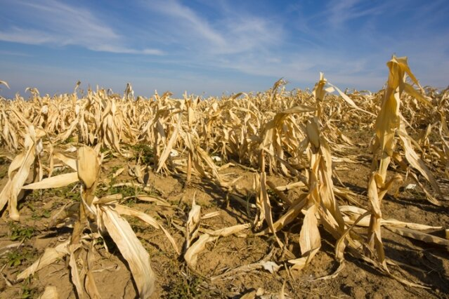
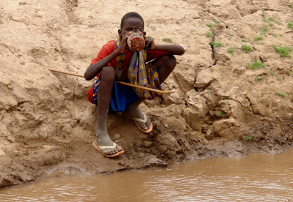
Why are you worried about climate change?
We humans are the ones who burn fossil fuels and chop down forests, causing average temperatures to rise worldwide. A warmer world has more evaporation, leading to more water in the atmosphere. Such changing conditions put our agriculture, health, water supply and more at risk. But it's not too late to slow the pace of climate change. We are fortunate to live in a beautiful and diverse planet. Our children, and all future generations, deserve the same.

Slide 4
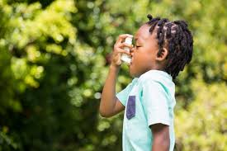
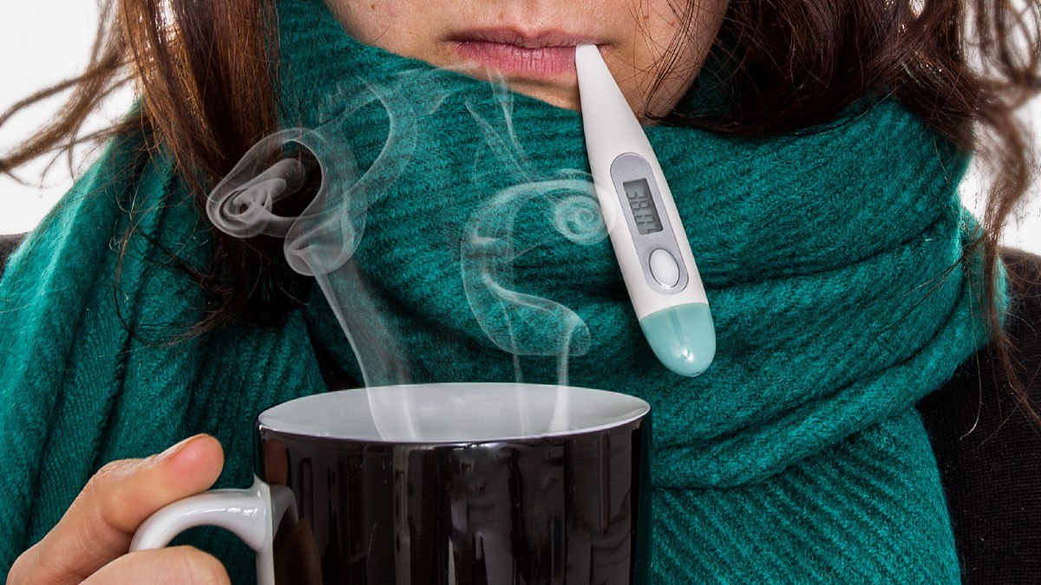
What consequences could climate change have for your life?
Climate change will affect all of us. From more extreme weather to increasing food prices, to recreation and decreased opportunities to appreciate the natural world. The main ways that climate change is already affecting people’s lives are:
health: Fossil fuel emissions contribute to various respiratory diseases – such as asthma – in children and adults and it could be quite dangerous.
There has been an increase in the number of heat-related deaths and a decrease in cold-related deaths.

Slide 5
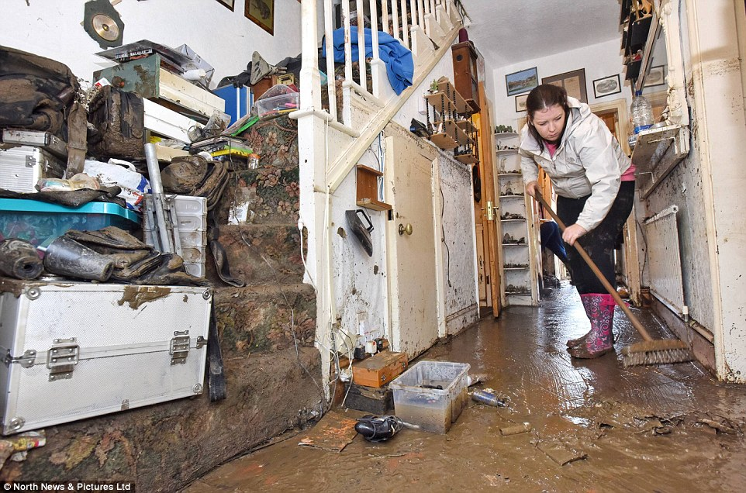
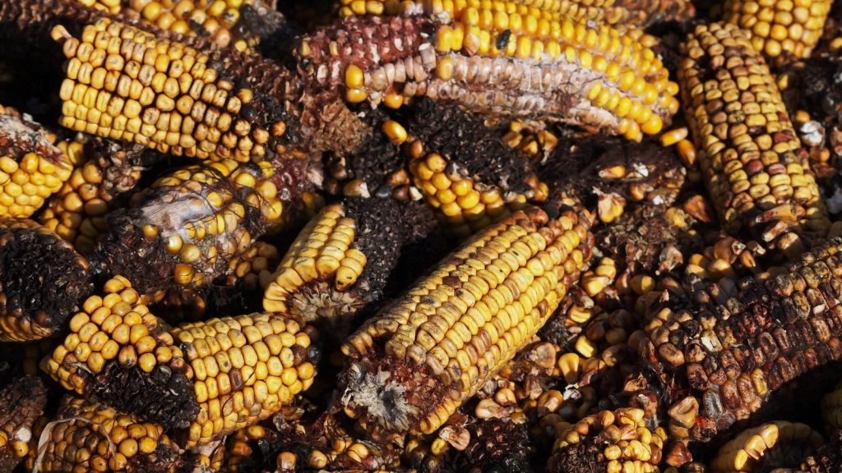
What consequences could climate change have for your life?
home: floods are the most common and deadly natural disasters in the U.S. Glaciers melt and ocean water expands, leading seas to rise. The added volume of water creeping up coastlines slowly swallows land and homes.
food: the same CO2 accumulating in our atmosphere thanks to fossil fuels is actually changing the composition of fruits and vegetables that we eat, making them less nutritious. Extra CO2 is speeding up photosynthesis and causing plants to grow with more sugar and less calcium, protein, zinc, and important vitamins.

